Slide 1

PRS PRACTICE MODULE · PROJECT PROPOSAL
GROUP 28
Indoor Dog Behavior &
Human–Dog Interaction
Recognition via dual-species RTMPose skeletons + ST-GCN temporal modeling
ZHAO JIAYI · SUN WENJING · GROUP 28

Slide 2
Pet Cameras See, but Don't Understand
01 · BACKGROUND
WHY THIS PROJECT
MARKET · 2024
GROWTH · 2024–2030
GAP
Pet cameras go mainstream
Demand keeps growing
Today's products only "see"
Owners treat dogs as family and want to know they are safe and well while away.
Expected to reach ~$454M by 2030, driven by owners treating pets as family.
Detect, track, push alerts. Did the dog eat? Did anyone play with it? Owners still scrub the footage.
$198M
12.6%
Understand
Global market size, 2024
Compound annual growth rate
The step this project adds
Source: Grand View Research, Pet Monitoring Camera Market Report

Slide 3
Make the Camera Understand the Dog
02 · OBJECTIVES
GOAL · A WORKING VIDEO-ANALYSIS PROTOTYPE
Upload an indoor video → get dog behavior, interaction type, confidence and a timeline.
TASK A
TASK B
Dog Behavior Recognition
Human–Dog Interaction
Dog only: infer what it is doing from how its skeleton moves over time.
Human and dog together: motion + human–dog relation + sound.
Input: dog skeleton sequence T × 17 × 3
Model: ST-GCN (LSTM baseline)
8 classes: stand · walk · run · sit · lie/sleep · eat/drink · play · other
Input: human + dog skeletons + relation features (optional audio)
Model: dual-stream ST-GCN, late fusion
4 classes: none · feeding · petting · playing together

Slide 4
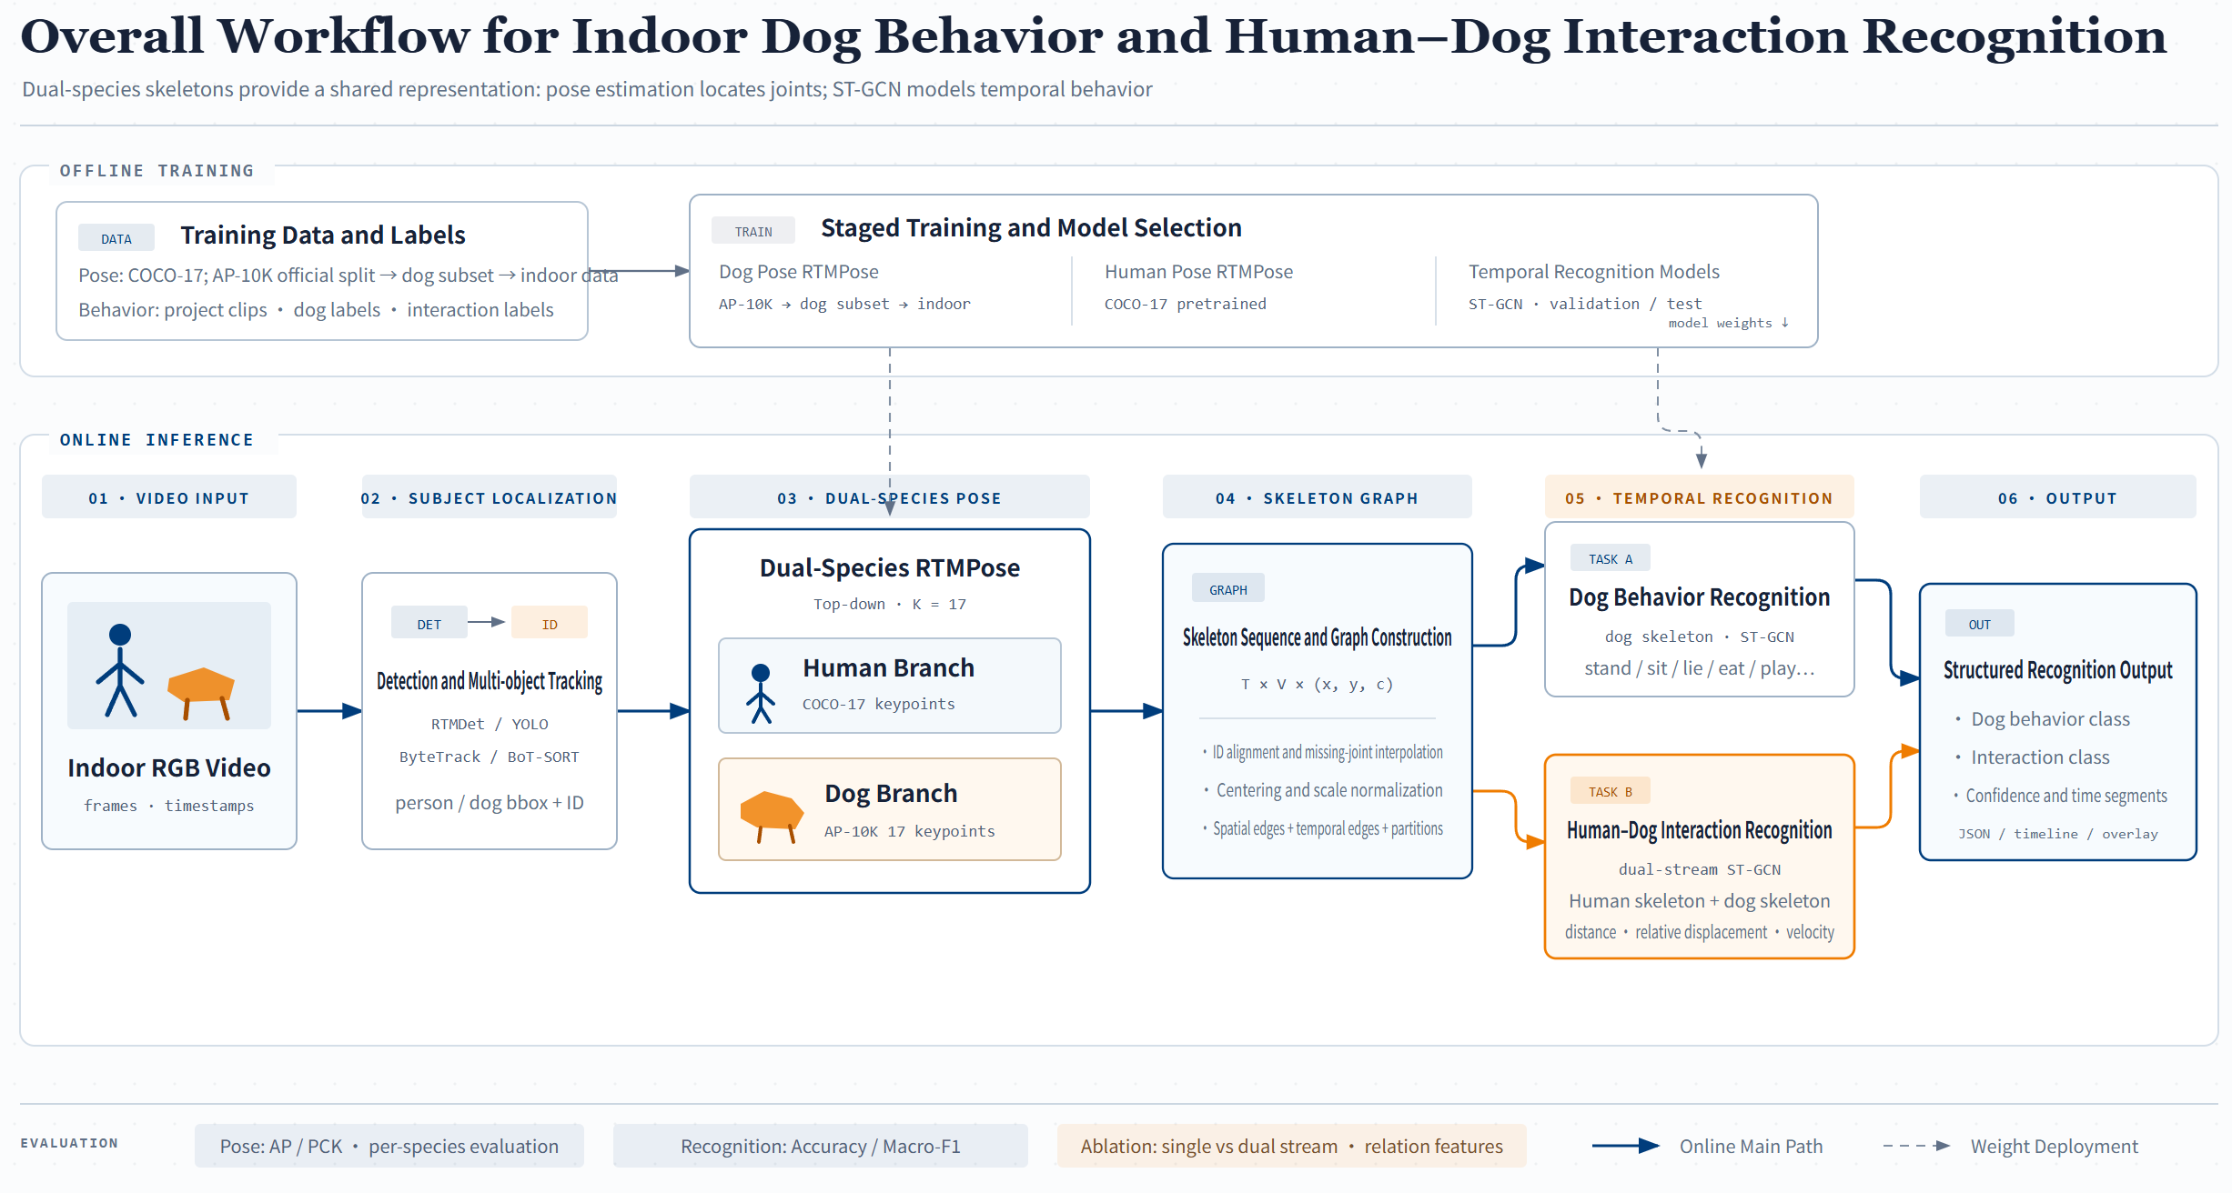
System Architecture
03 · SYSTEM & DATA
SYSTEM OVERVIEW
Offline: dog pose AP-10K → APT-36K dogs → indoor data; human pose COCO-17
Online in 6 steps: video → detect/track → pose → skeleton graph → recognition → output
Tracking: RTMDet / YOLO + ByteTrack / BoT-SORT
Dual-species skeletons are the shared representation: pose estimation sees the joints, ST-GCN understands the motion.
INFERENCE
TASKS
METRICS
6
2
4
Video in, JSON + timeline out
Task A behavior · Task B interaction
AP / PCK · Acc / Macro-F1

Slide 5
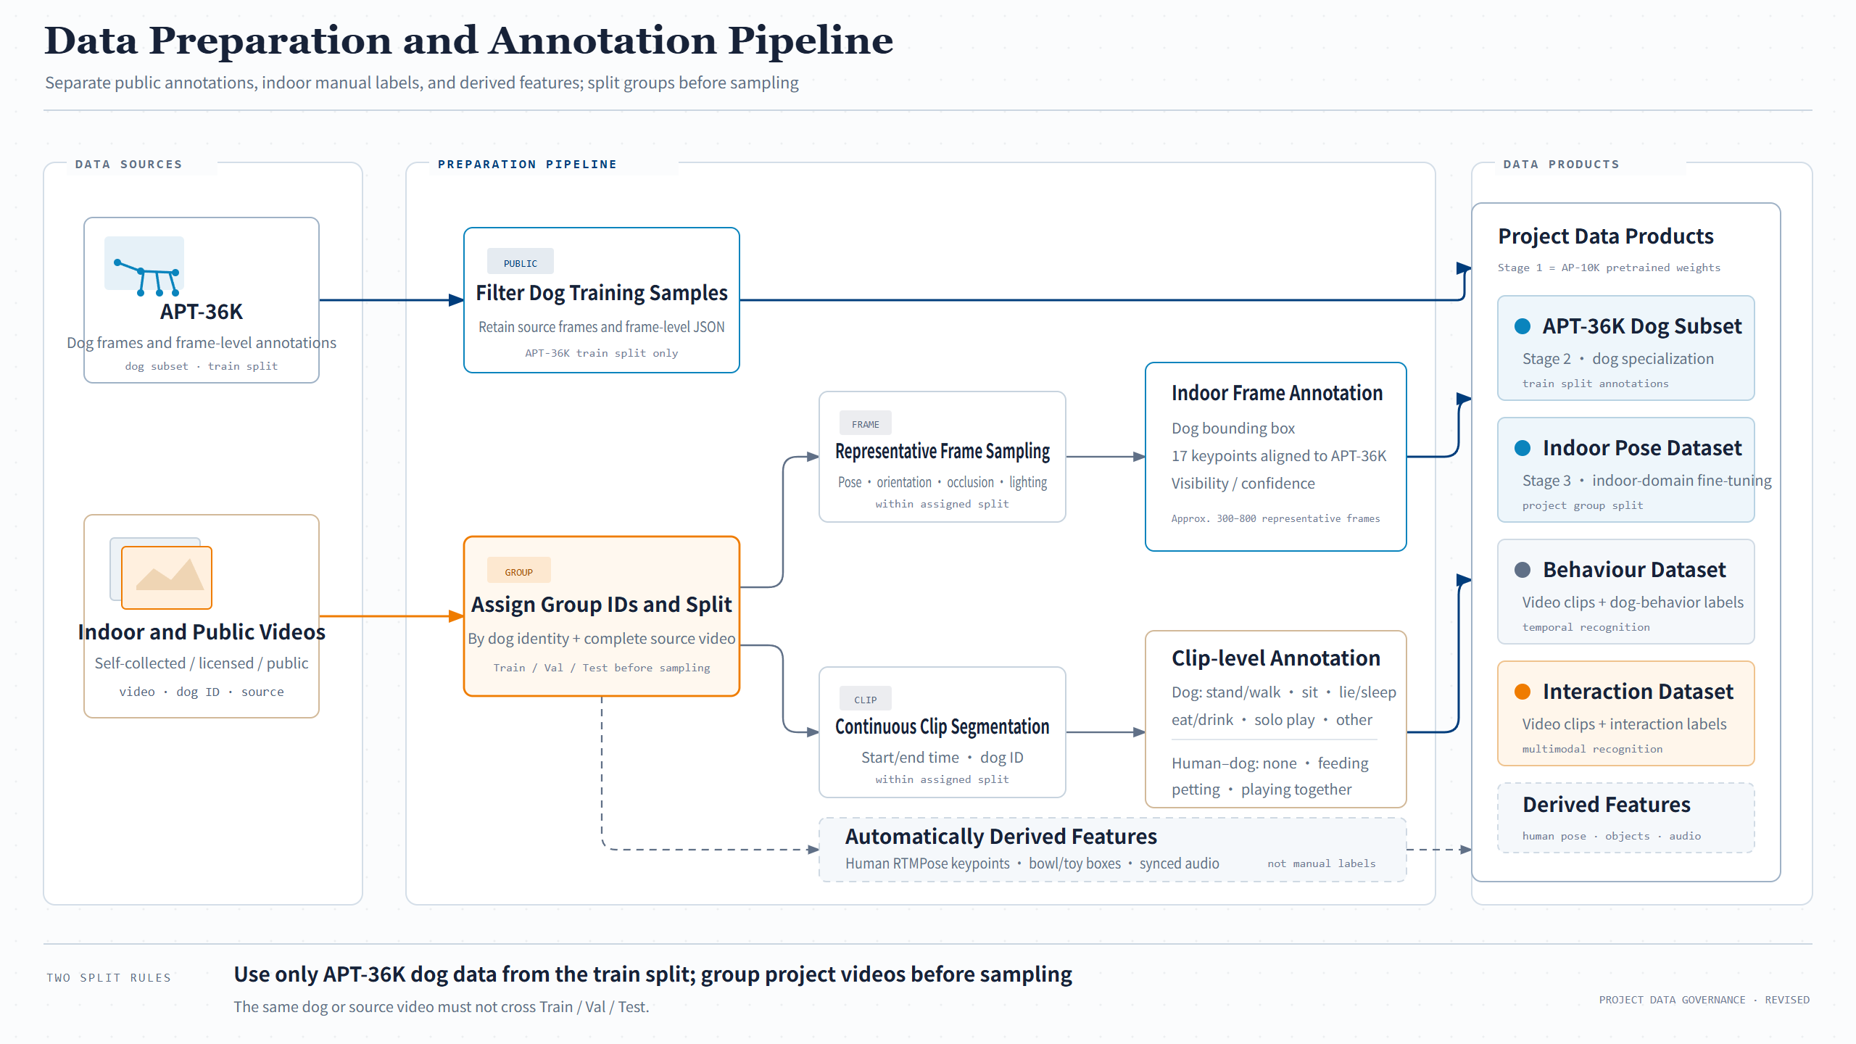
Where the Data Comes From
03 · SYSTEM & DATA
DATA PREPARATION
① APT-36K: official split, dog samples only, no re-labeling
② Online videos: Group ID per dog + full video, split first, then sample frames and clips
Split first, sample later: one dog or video never spans train and test
AP-10K is RTMPose's pretraining set, so we don't train on it again; public dog pose data comes from APT-36K.
SOURCES
FRAME LABELS
OUTPUTS
2
300–800
3
APT-36K dogs · indoor videos
indoor images: dog box + 17 keypoints
Keypoints · clip labels · derived features

Slide 6
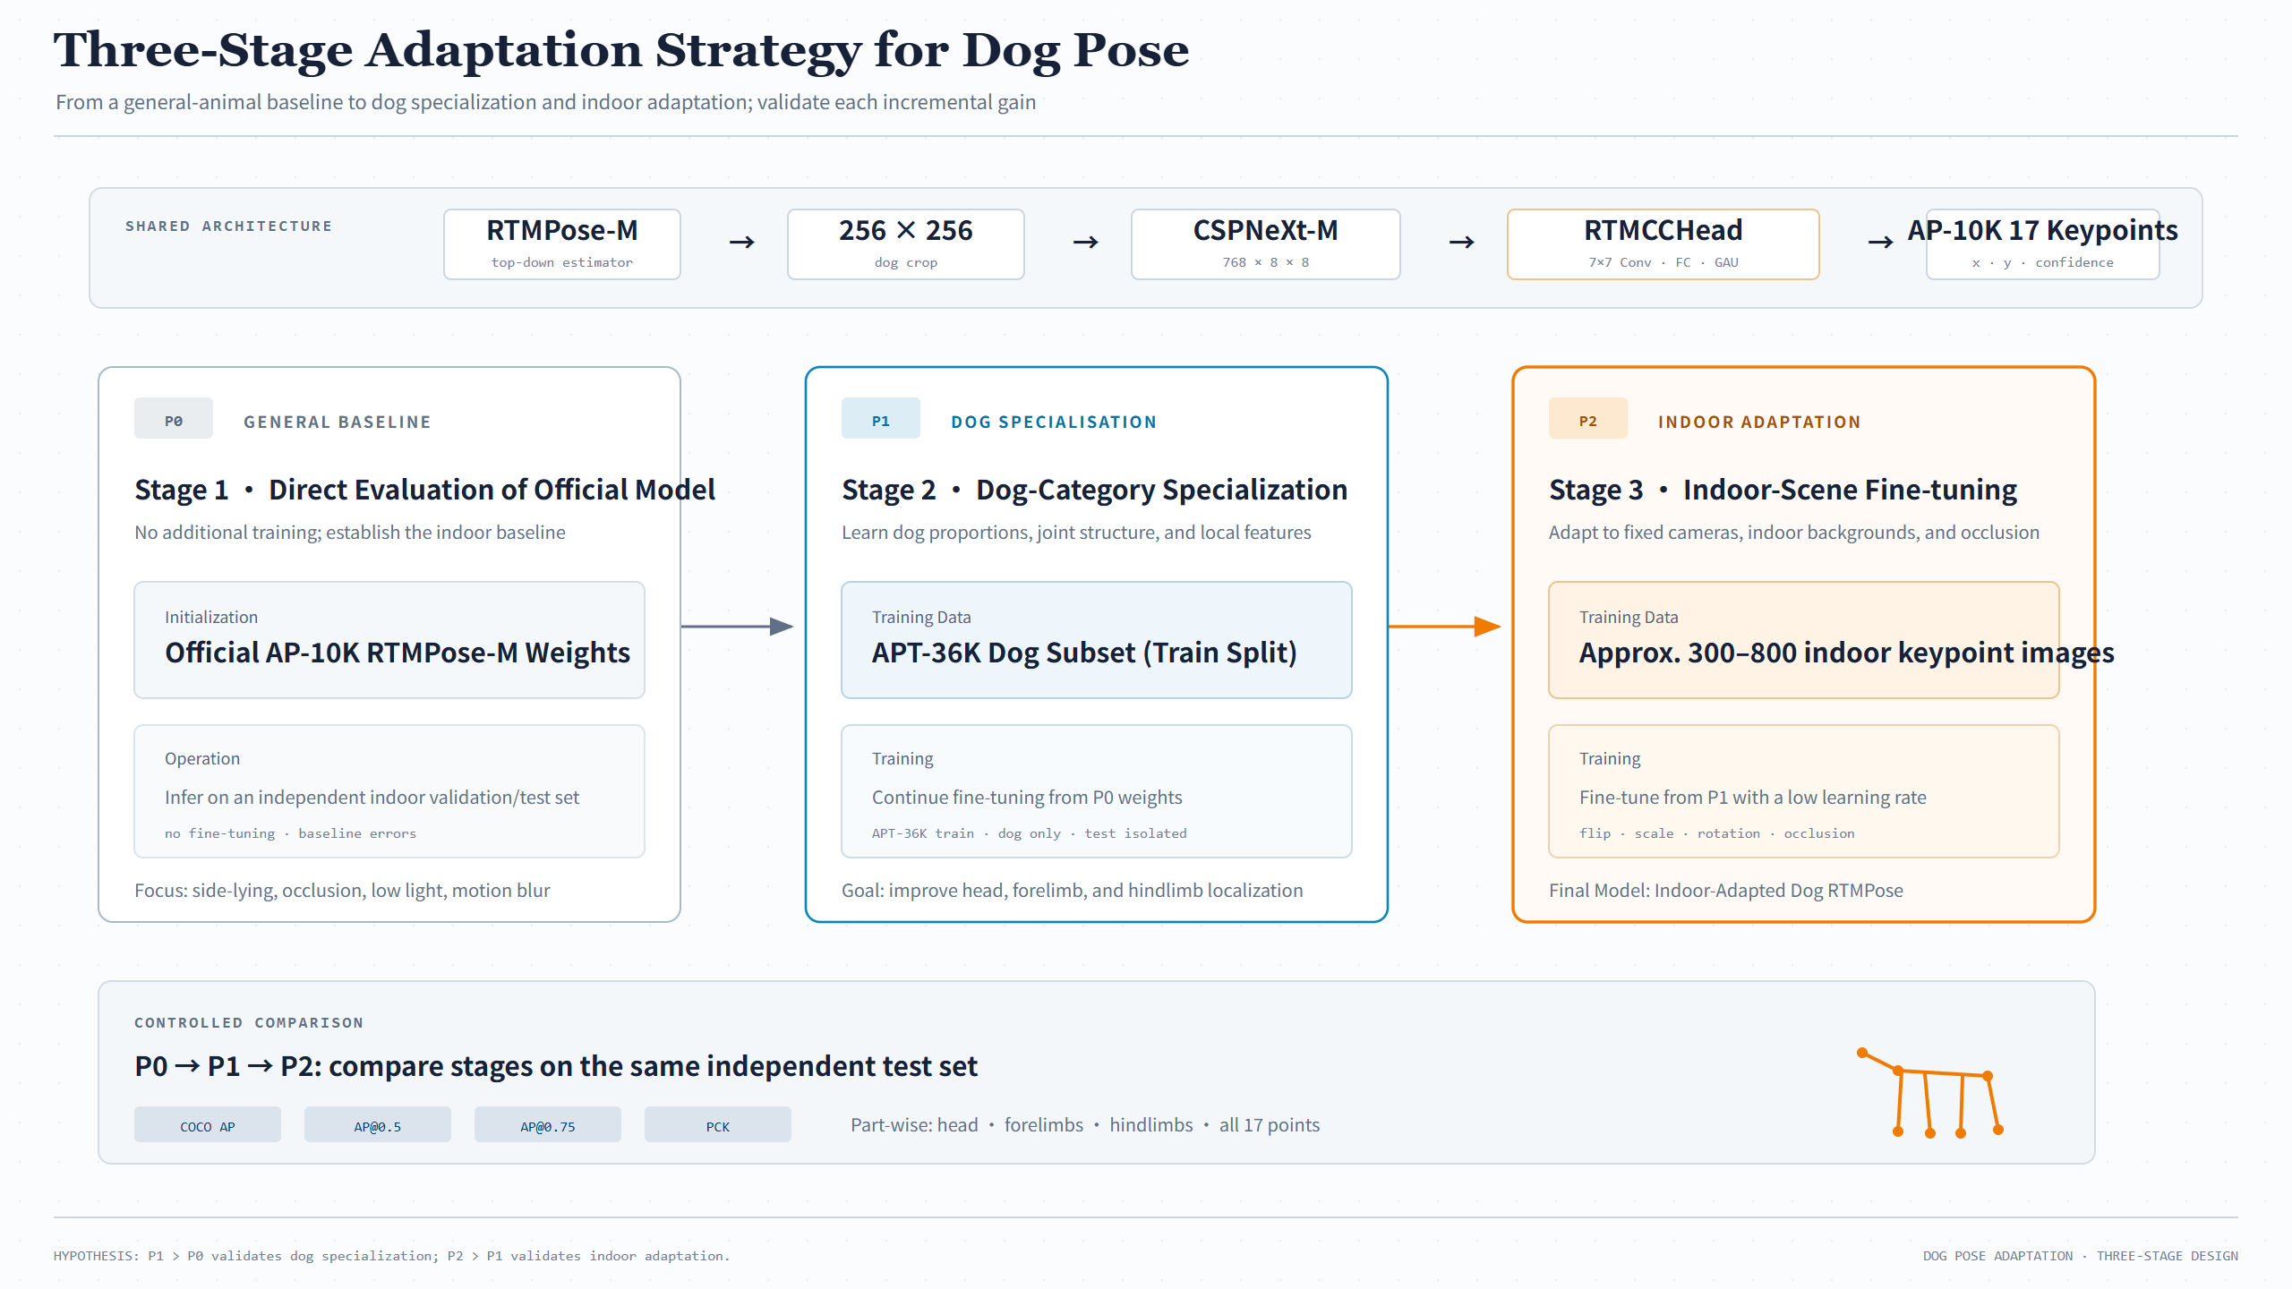
Training Dog Pose
03 · SYSTEM & DATA
DOG POSE ADAPTATION
P0: official AP-10K RTMPose-M, tested as-is (baseline)
P1: fine-tune on the APT-36K dog subset
P2: keep fine-tuning on indoor data with a small learning rate
One shared test set. If P1 beats P0, dog specialization helps; if P2 beats P1, indoor adaptation helps.
VERSIONS
TEST SET
POSE METRICS
3
1
4
P0 → P1 → P2, stage by stage
One held-out test set for all three
COCO AP · AP@0.5 · AP@0.75 · PCK

Slide 7
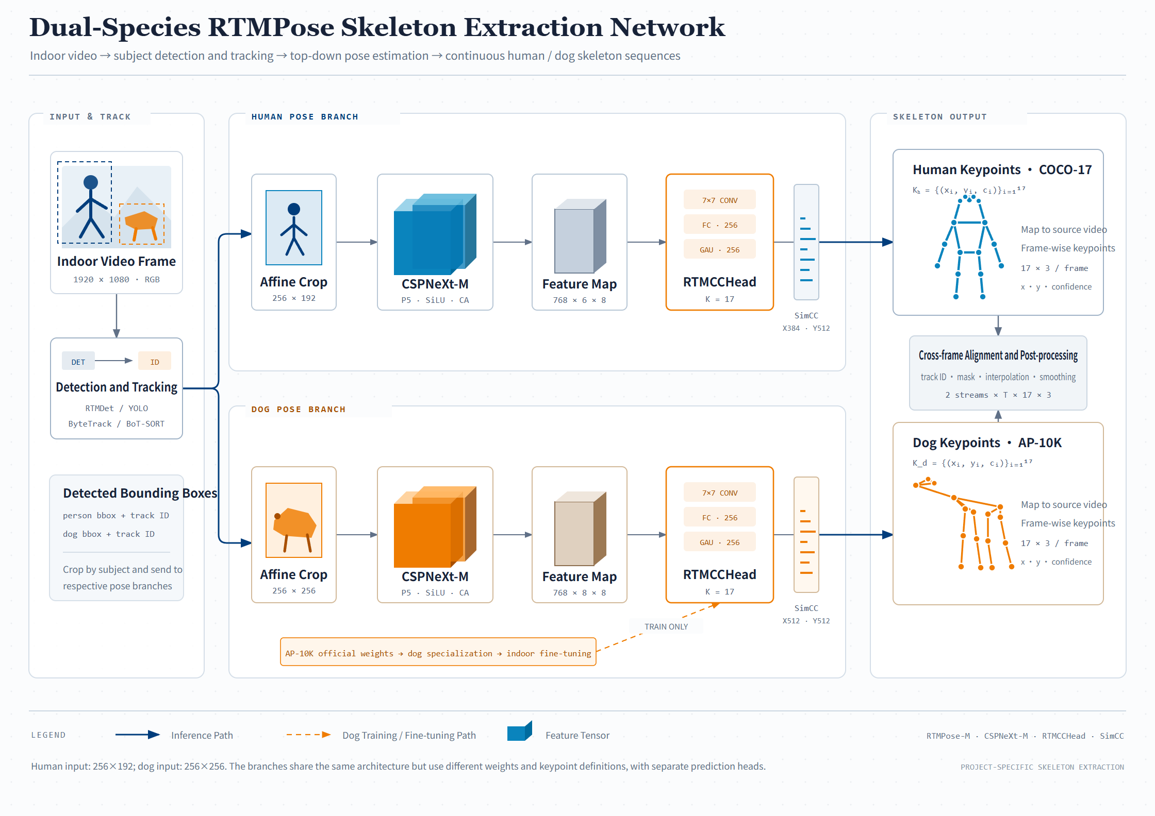
Dual-Species Skeleton Extraction
04 · MODEL DESIGN
ONLINE STEP 03 · POSE
Human and dog branches share one design: affine crop → CSPNeXt-M → RTMCCHead → SimCC
Only input size differs (human 256×192, dog 256×256); no shared weights
Aligned across frames by track ID, then masked, interpolated and smoothed
RTMCCHead = 7×7 conv + FC + GAU; SimCC turns coordinate regression into classification.
BACKBONE
KEYPOINTS
OUTPUT
768
17
2×T×17×3
CSPNeXt-M output channels
Human COCO · dog AP-10K
2 streams · x, y, confidence

Slide 8
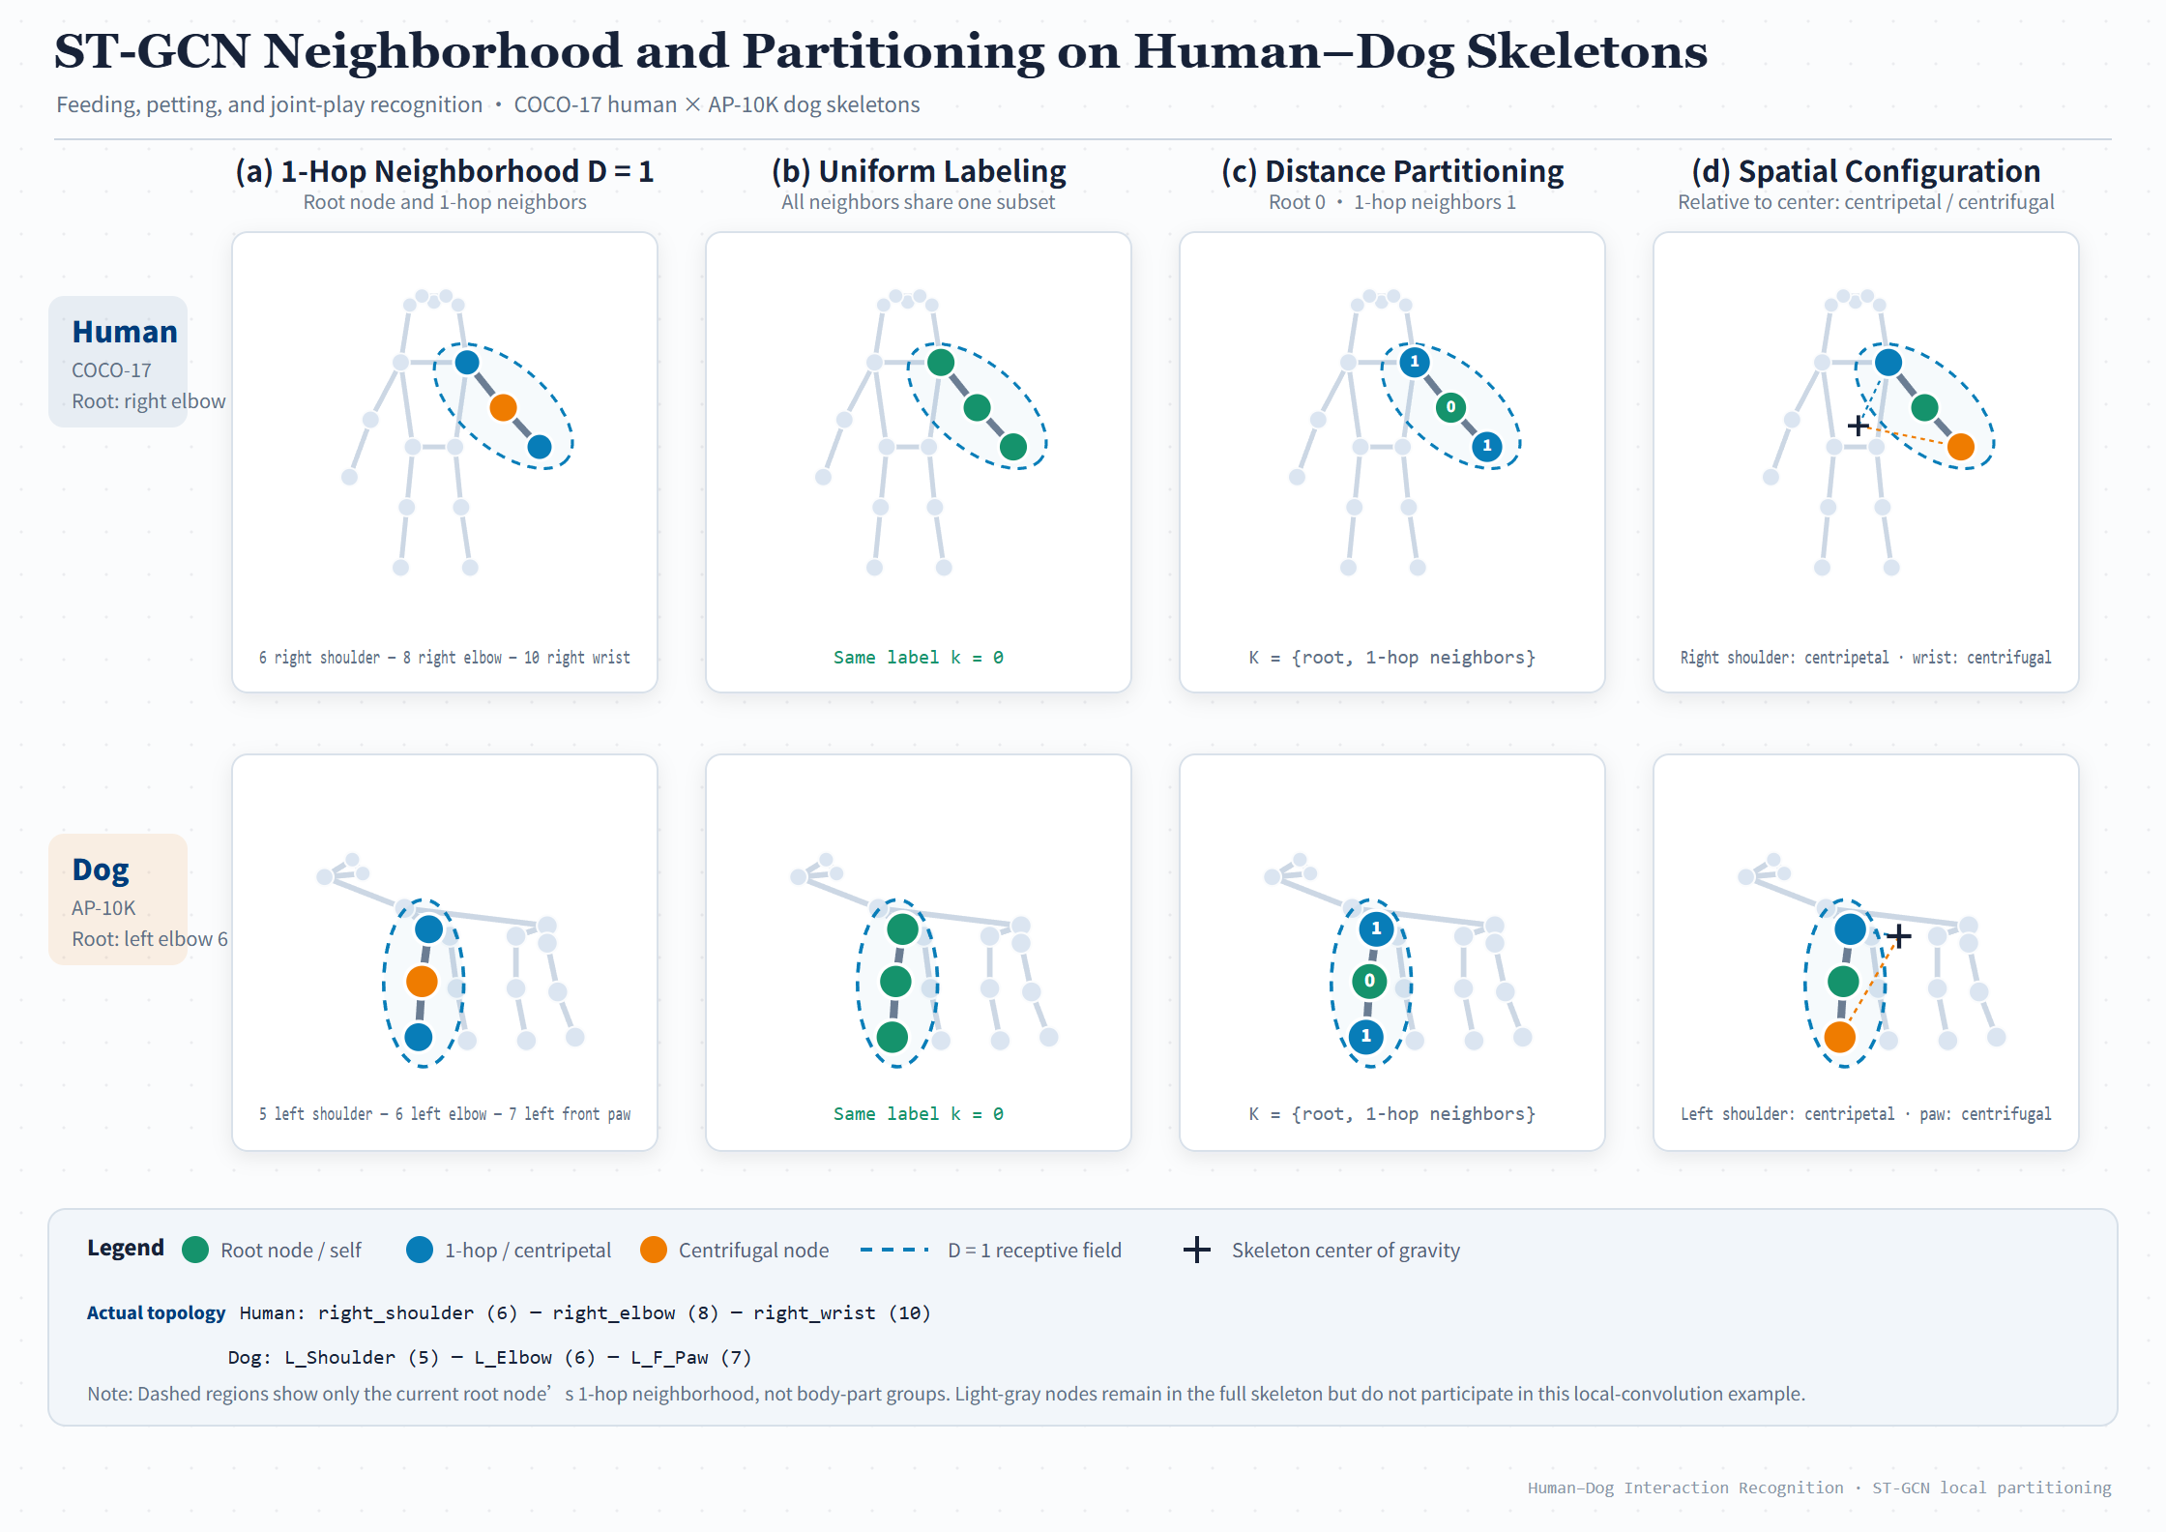
How Graph Convolution Works
04 · MODEL DESIGN
ST-GCN PRINCIPLE
Example: human right elbow and dog left elbow with their 1-hop neighbors (D = 1)
Uni-labeling: 1 group; distance: root / 1-hop, 2 groups
Spatial configuration: root, centripetal, centrifugal by distance to the center of gravity, 3 groups
Both networks use spatial configuration partitioning: one adjacency matrix per group, A₀, A₁, A₂.
STRATEGIES
NEIGHBORHOOD
ADJACENCY
3
D = 1
A₀ A₁ A₂
Uni-label · distance · spatial
Root node and 1-hop neighbors
Spatial config., shared by Task A / B

Slide 9
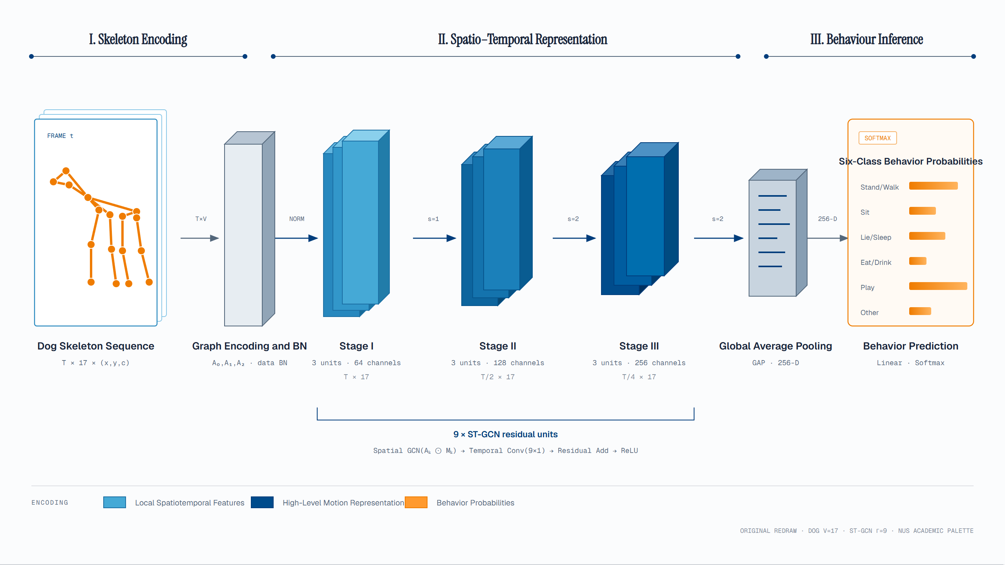
Task A
Dog Behavior
04 · MODEL DESIGN
ONLINE STEP 05 · TASK A
Follows the original ST-GCN (Yan et al., AAAI 2018)
9 residual units in 3 stages: channels 64 → 128 → 256, time T → T/2 → T/4
Global average pooling → Linear + Softmax; baseline: LSTM
Each unit: spatial graph conv (A₀–A₂), then 9×1 temporal conv, then residual add.
RESIDUAL UNITS
FEATURE
CLASSES
9
256-D
6
3 stages × 3 units
After global average pooling
Stand · sit · lie · eat · play · other

Slide 10
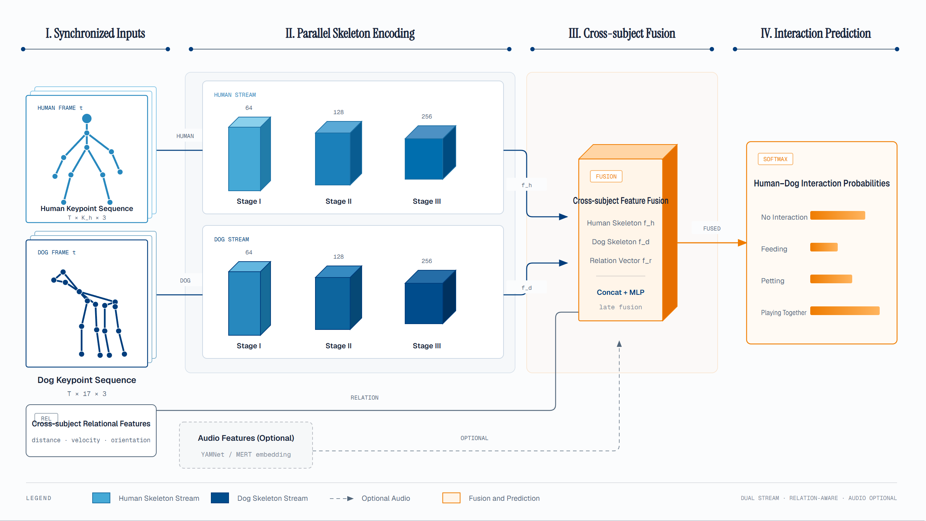
Task B
Interaction
04 · MODEL DESIGN
ONLINE STEP 05 · TASK B
Human and dog skeletons each go through an ST-GCN → f_h and f_d
Plus relation features f_r (distance, velocity, orientation) and optional audio (YAMNet / MERT)
Concat + MLP at the end: late fusion
Late fusion keeps audio optional: with no or poor sound, the skeletons alone still give a prediction.
STREAMS
RELATION
CLASSES
2
3
4
Human + dog, one ST-GCN each
Distance · velocity · orientation
None · feeding · petting · play

Slide 11
How We Prove Each Step Works
05 · EVALUATION
EVALUATION PLAN
01 / POSE
02 / TASK A
03 / TASK B
04 / SPLIT
Pose
Dog Behavior
Interaction
Robustness
COCO AP · AP@0.5 · AP@0.75 · PCK
Accuracy · Macro-F1 · confusion matrix
Same metrics + ablations
Unseen dogs and scenes
P0 / P1 / P2 on the same test set, reported for head, forelimbs and hindlimbs.
LSTM vs ST-GCN; ablate confidence, missing-joint handling, skeleton augmentation.
Single vs dual stream
± relation features
± audio
Split by dog + full video
Occlusion, missing joints
Multi-subject, no audio
RULE
Val set for model selection only; test set used once at the end, the same one for every comparison.

Slide 12
12 / 12
TAKEAWAYS
01
Skeletons link everything
THANK YOU
Q&A
Pose estimation sees joints; ST-GCN understands motion over time.
02
Every step is testable
P0 → P1 → P2 and ablations answer "does it help?" one by one.
03
Leak-free data split
Grouped by dog and full video: we test on unseen dogs and scenes.
GROUP 28 · ZHAO JIAYI · SUN WENJING

